Slide 1
Project Management Plan
Jessica Bolson

Slide 2
Steering Committee
Michael Sukop (Managing PI, FIU)
Jennifer Rehage (FIU)
Kenny Broad (U Miami)
David Watkins (Mich. Tech)
Julie Harrington (FSU)
Graduate Student(s)
External Advisory Board
Upmanu Lall (Columbia U) Tanya Heikkila (U CO-Denver)
Wendy Graham (UF)
Vic Engel (USGS)
Jayantha Obeysekera
(SFWMD)
Project Coordinator
Jessica Bolson
(UPenn)
Admin. support
F
A
Q
Q
Q
Stakeholders
Task Group 1
Task lead
Team
University lead(s)
Task Group 2
Task lead
Team
University lead(s)
Task Groups 3-7
Task lead
Team
University lead(s)
F
F
F
F
Q,A
A
Web portal
Michael Sukop
Interaction/Reporting schedule
F = Frequent, as needed from
continuous to weekly
Q = Quarterly at a minimum
A = Annual
Annual meetings
Student symposia
A

Slide 4
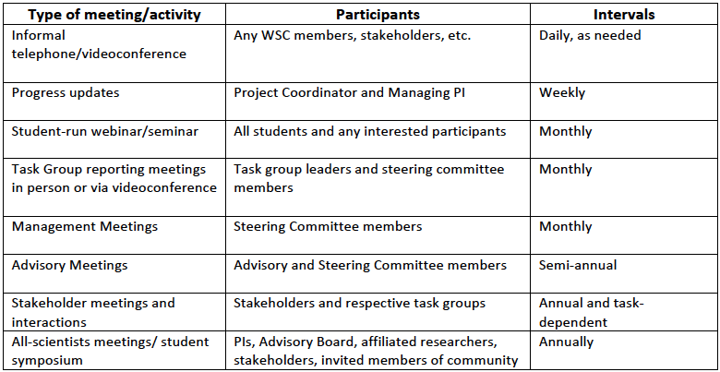

Slide 5
